Slide 1
AFCARS Trends in Foster Care and Adoption 2008-2017
File created on: 6/17/2019 9:51:02 AM

Slide 2
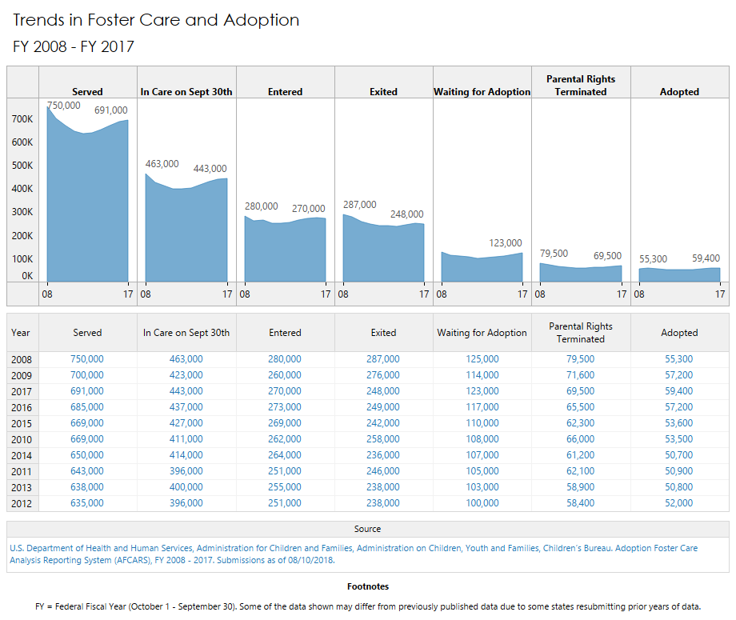

Slide 3
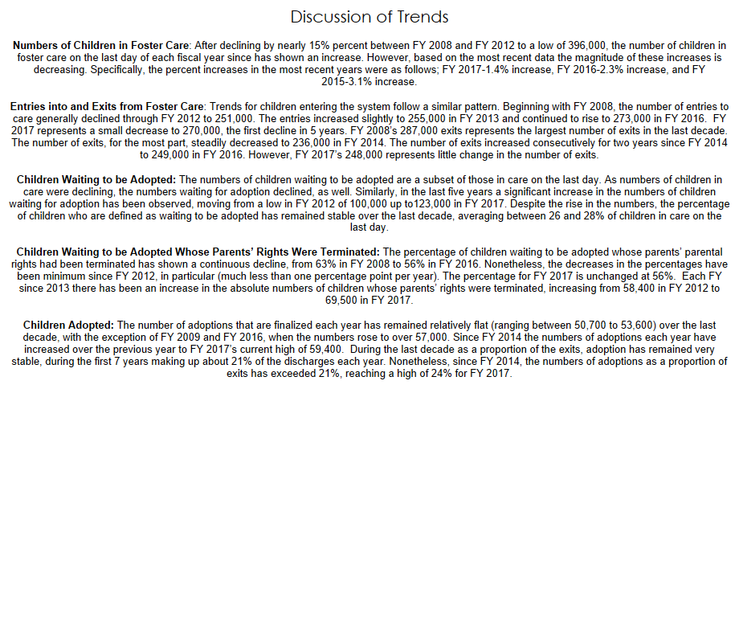

Slide 4
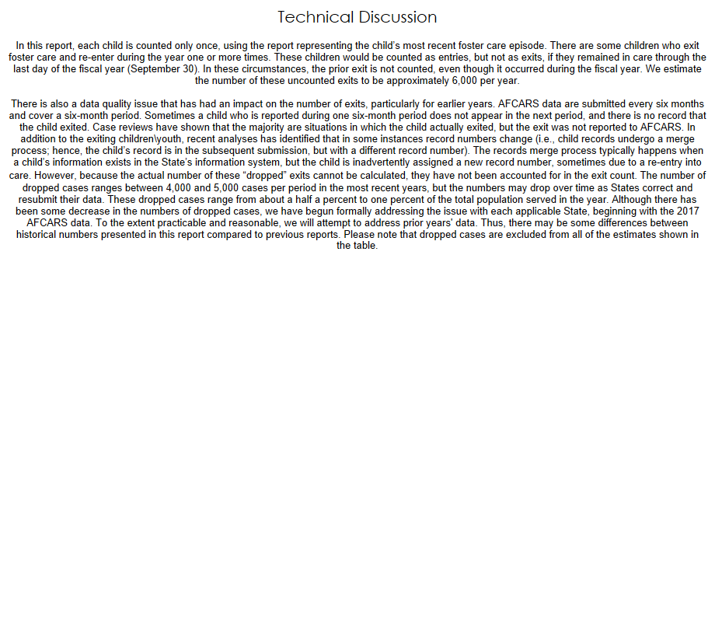

Slide 5
